Slide 1

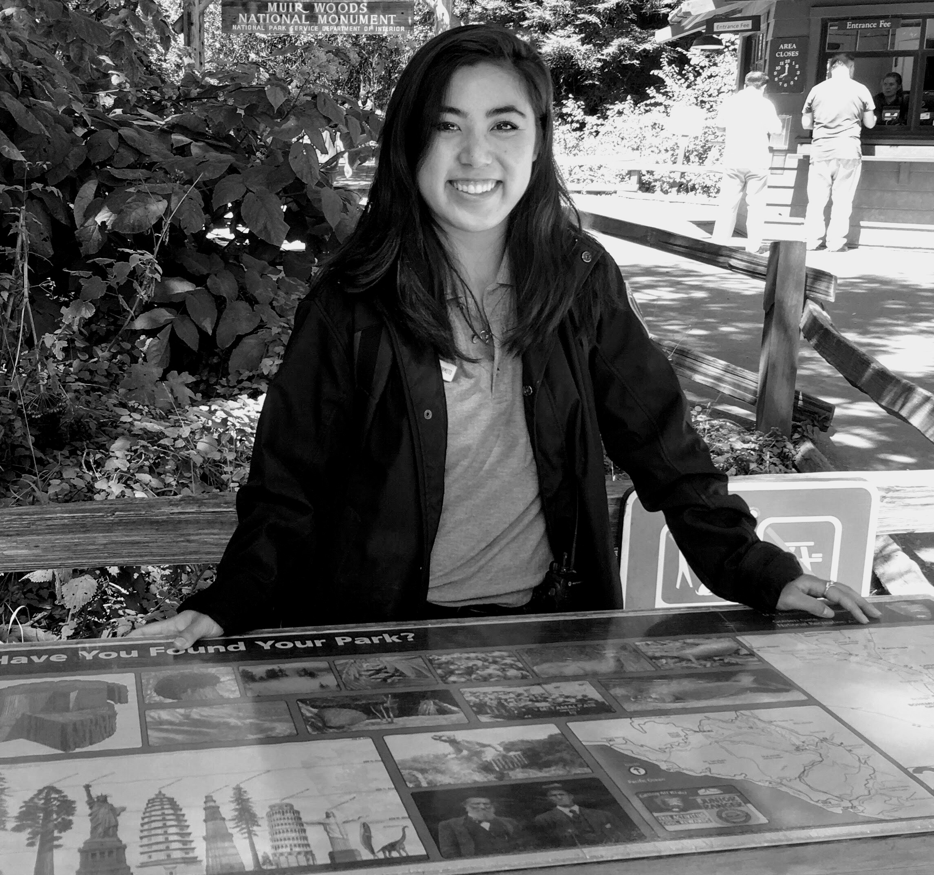
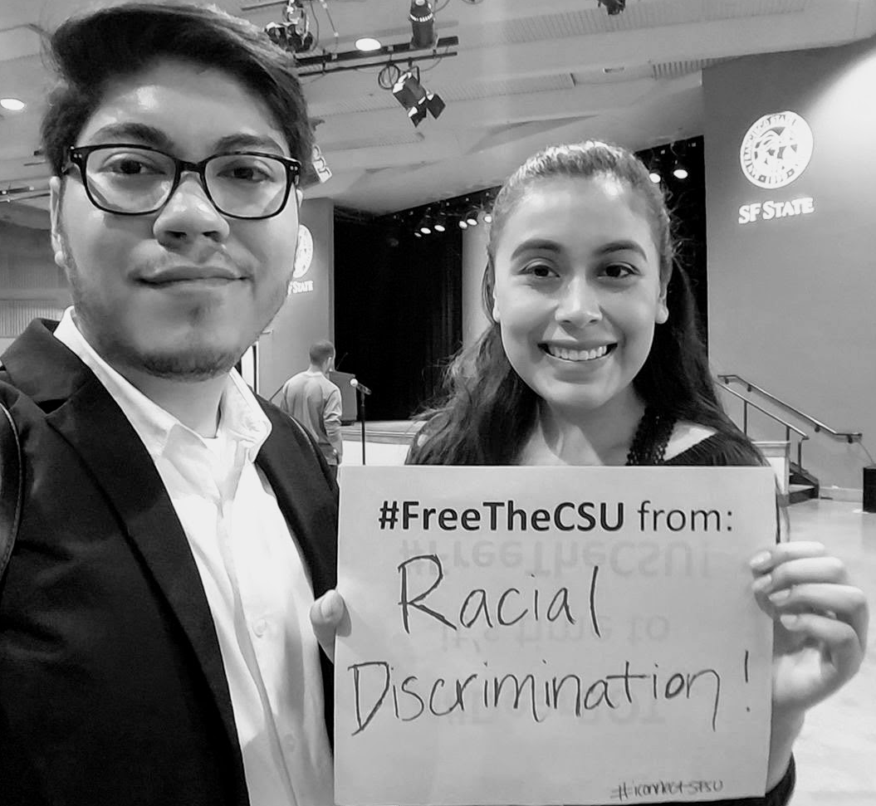
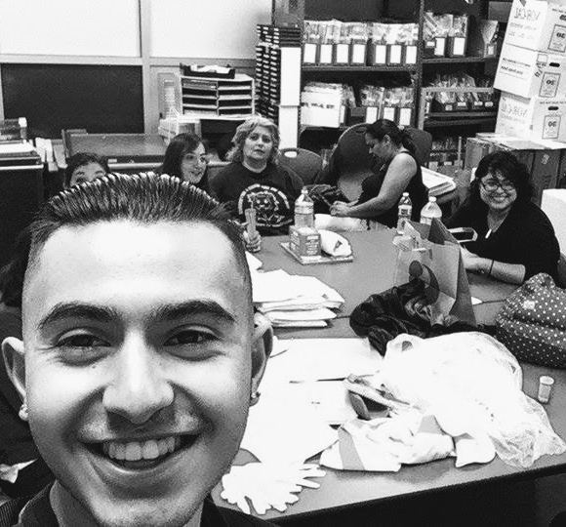
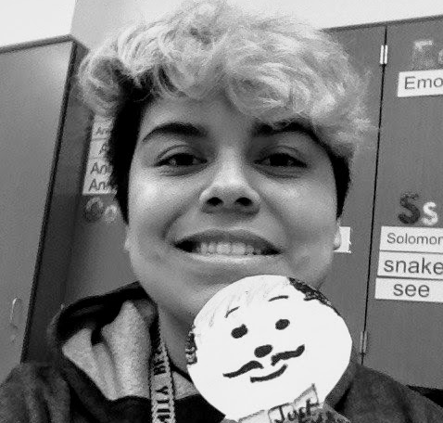
CHSS Teaching Academy & Institute for Civic and Community Engagement
Reflective Service Learning and Social Justice Pedagogy Workshop
Monday, Feb. 17th | 12:00pm-2:00pm
Notes:
NINA –

Slide 2


Workshop overview
Facilitators:
Nina Roberts, Director, ICCE; Professor, RPT
Maria J. Veri, Faculty Director, CHSS TA; Associate Professor, KIN
Welcome & introductions
ICCE & CHSS Teaching Academy: Overview
SL & SJ: Sample definitions, outcomes, best practices
Developing/designating service-learning courses
Develop SJ-infused syllabi for SL course
Discussion | Q & A
(Pew Social Trends, 2012; U.S. Census, 2012)
Notes:
NINA

Slide 3
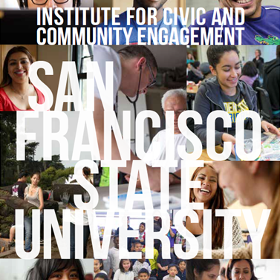
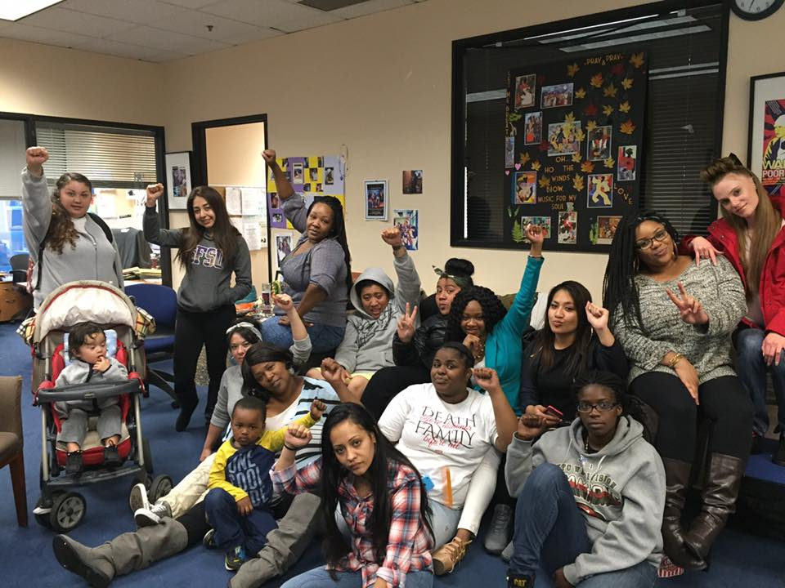
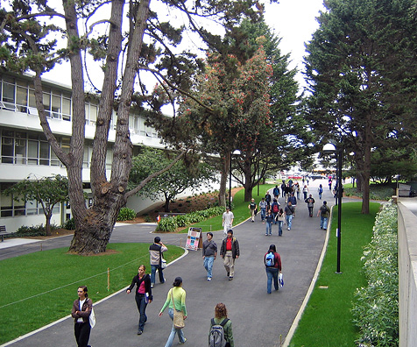
ICCE Mission
“To connect SF State faculty, staff, and students with the Bay Area community through strategic partnerships that help develop civic & social responsibility leading to positive impacts in communities”
Notes:
JOSE

Slide 4
CHSS TEACHING ACADEMY
Mission
“To support CHSS teachers at all ranks and levels of experience (Graduate Teaching Assistants, Instructional Aids, lecturer faculty, and tenured/tenure track faculty members), and to foster a communal culture of reflective, inclusive, and intentional teaching practices.”
      
These practices are aimed at creating CHSS teaching that is accessible, community-engaged, and informed by social justice pedagogy.
Notes:
Maria

Slide 5

CHSS Teaching Academy Goals:
Cultivate faculty engagement, retention, and a sense of belonging within CHSS through teaching and learning
Promote student engagement, retention, and a sense of belonging within CHSS through teaching and learning
Develop a repository of resources and a sustainable structure to support inclusive and equitable teaching practices
Develop systems by which critically engaged, inclusive excellence in teaching is deeply valued and supported by the CHSS community
Notes:
Maria

Slide 6







Opportunities for Student Leadership
Signature Programs
Work-Study
America Reads & America Counts
Internships
- Panetta Congressional Internship
- JusticeCorps Internship
- Golden Gate National Parks
* Academic Internship Program
- Neighborhood Empowerment Network
Internship
Fellowships
Civic Engagement Fellows
Notes:
JOSE

Slide 7
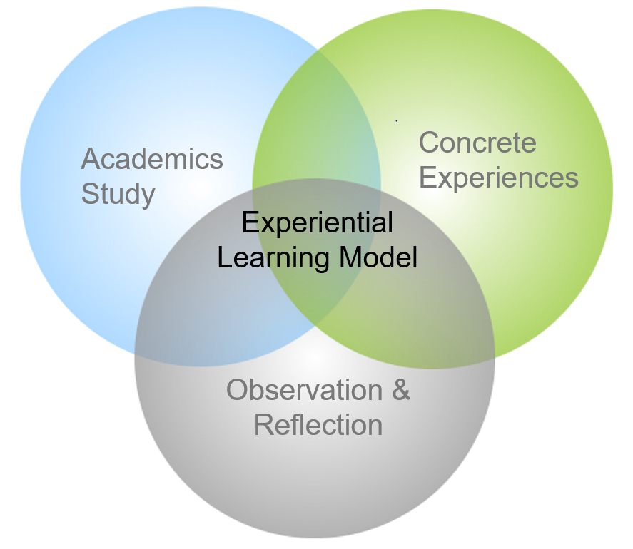
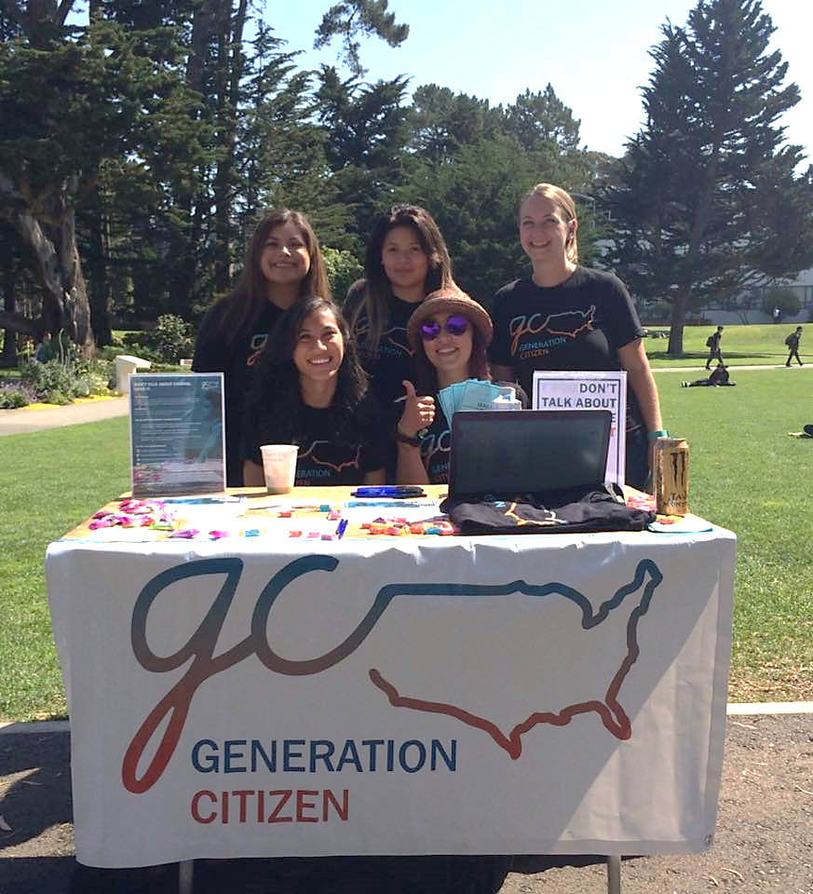

Service-Learning
Source: Jacoby, B. (2014). Service-Learning Essentials: Questions, Answers, and Lessons Learned. San Francisco, CA: John Wiley & Sons.
Notes:
JOSE
Evidence to support that service-learning would have a positive impact on the academic and social integration of college students.

Slide 8
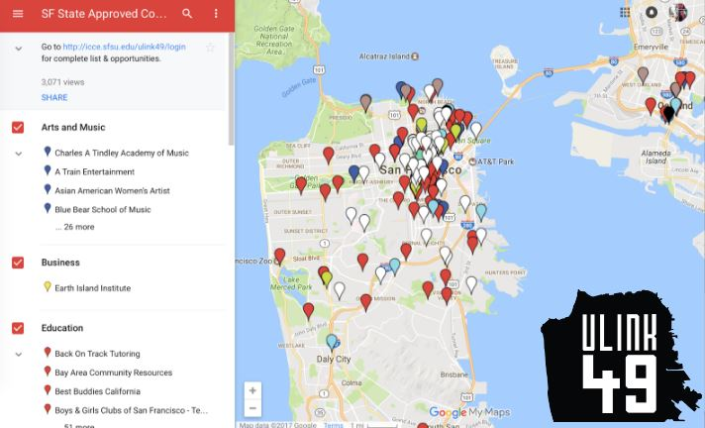
Community Service-Learning
Student Opportunities
Brings the classroom to life...
Academic & Professional Preparation
  Service hours on transcripts
  “Real world”, hands-on opportunities
Intentional reflection on experience
200+ courses
  35 General Education Courses
Over 250 partners
Boost graduate school applications
Resume builder
“SF State ULink” Online Database –
Notes:
GLENDIE

Slide 9
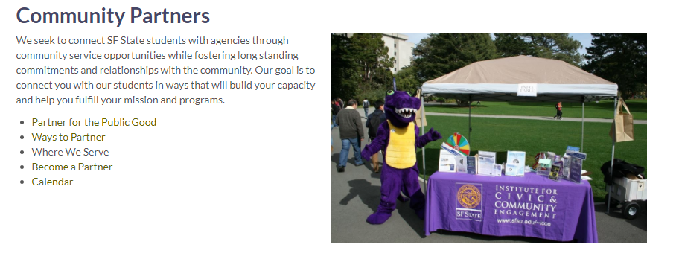
Working with Community Partners
ICCE connects students with agencies through service learning opportunities while fostering long standing commitments and relationships with the local orgs/leaders -
Goal: Connect partners with our students in ways that build their capacity and help them fulfill their service projects, assignments and professional aspirations.
Partner for the public good
Ways to partner
Where we serve
Become a partner
Calendar of events
http://icce.sfsu.edu/comm_partners
ICCE staff can provide faculty with support, ideas, connections
Notes:
GLENDIE

Slide 10
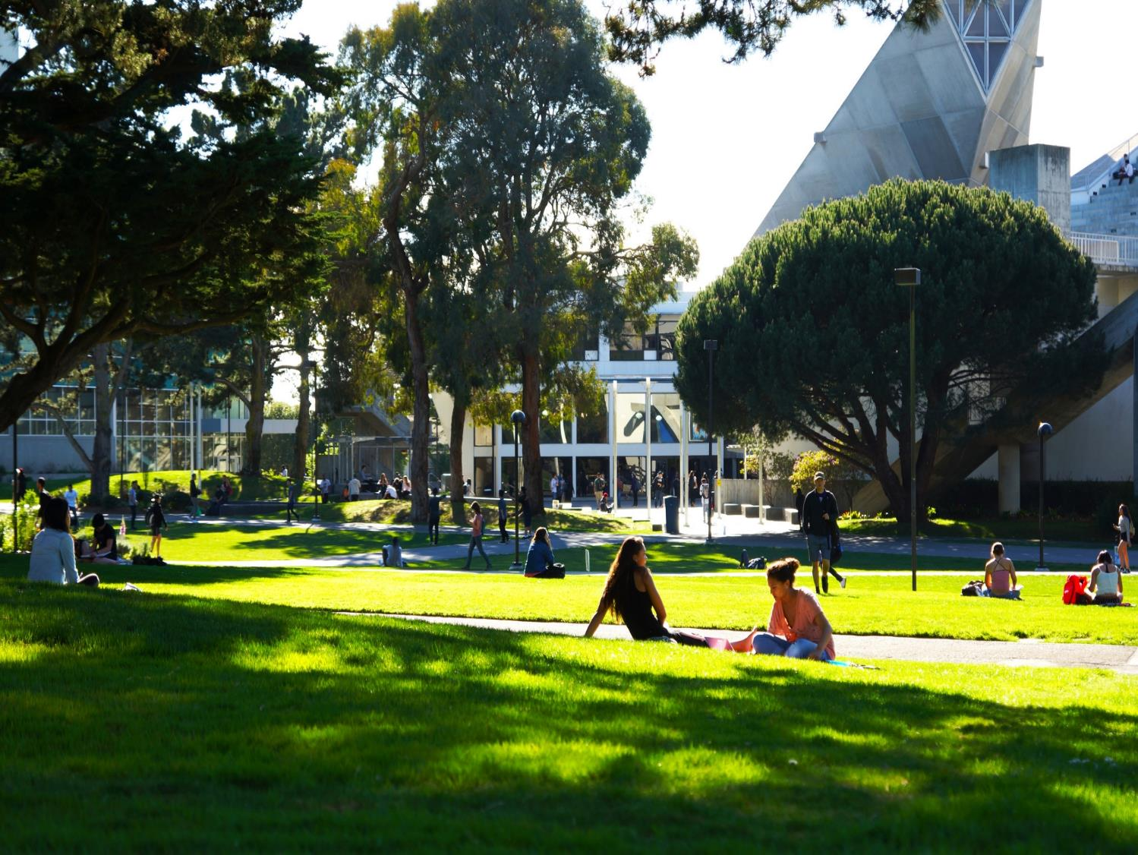
What does it mean?
Community Service Learning (CSL)
“The combination of academic study with community service so that each is enhanced by the other. Through a process of structured reflection, the service experience is integrated with the lessons of the classroom to enrich learning outcomes.”
(SFSU, Institute for Civic & Community Engagement)
Notes:
EUNICE

Slide 11
Service Learning
A process through which students are involved in community work that contributes significantly to . . .
positive change in individuals, organizations, neighborhoods,
and/or larger systems in a community
student’s academic understanding, civic development, personal or career growth, and/or understanding of larger social justice issues

It’s a process! Always includes an intentional and structured, educational and developmental component for students. . .
Will undoubtedly continue to play a critical role in
campus-community collaboration
(AAC&U, adapted for ICCE)
Notes:
EUNICE

Slide 12
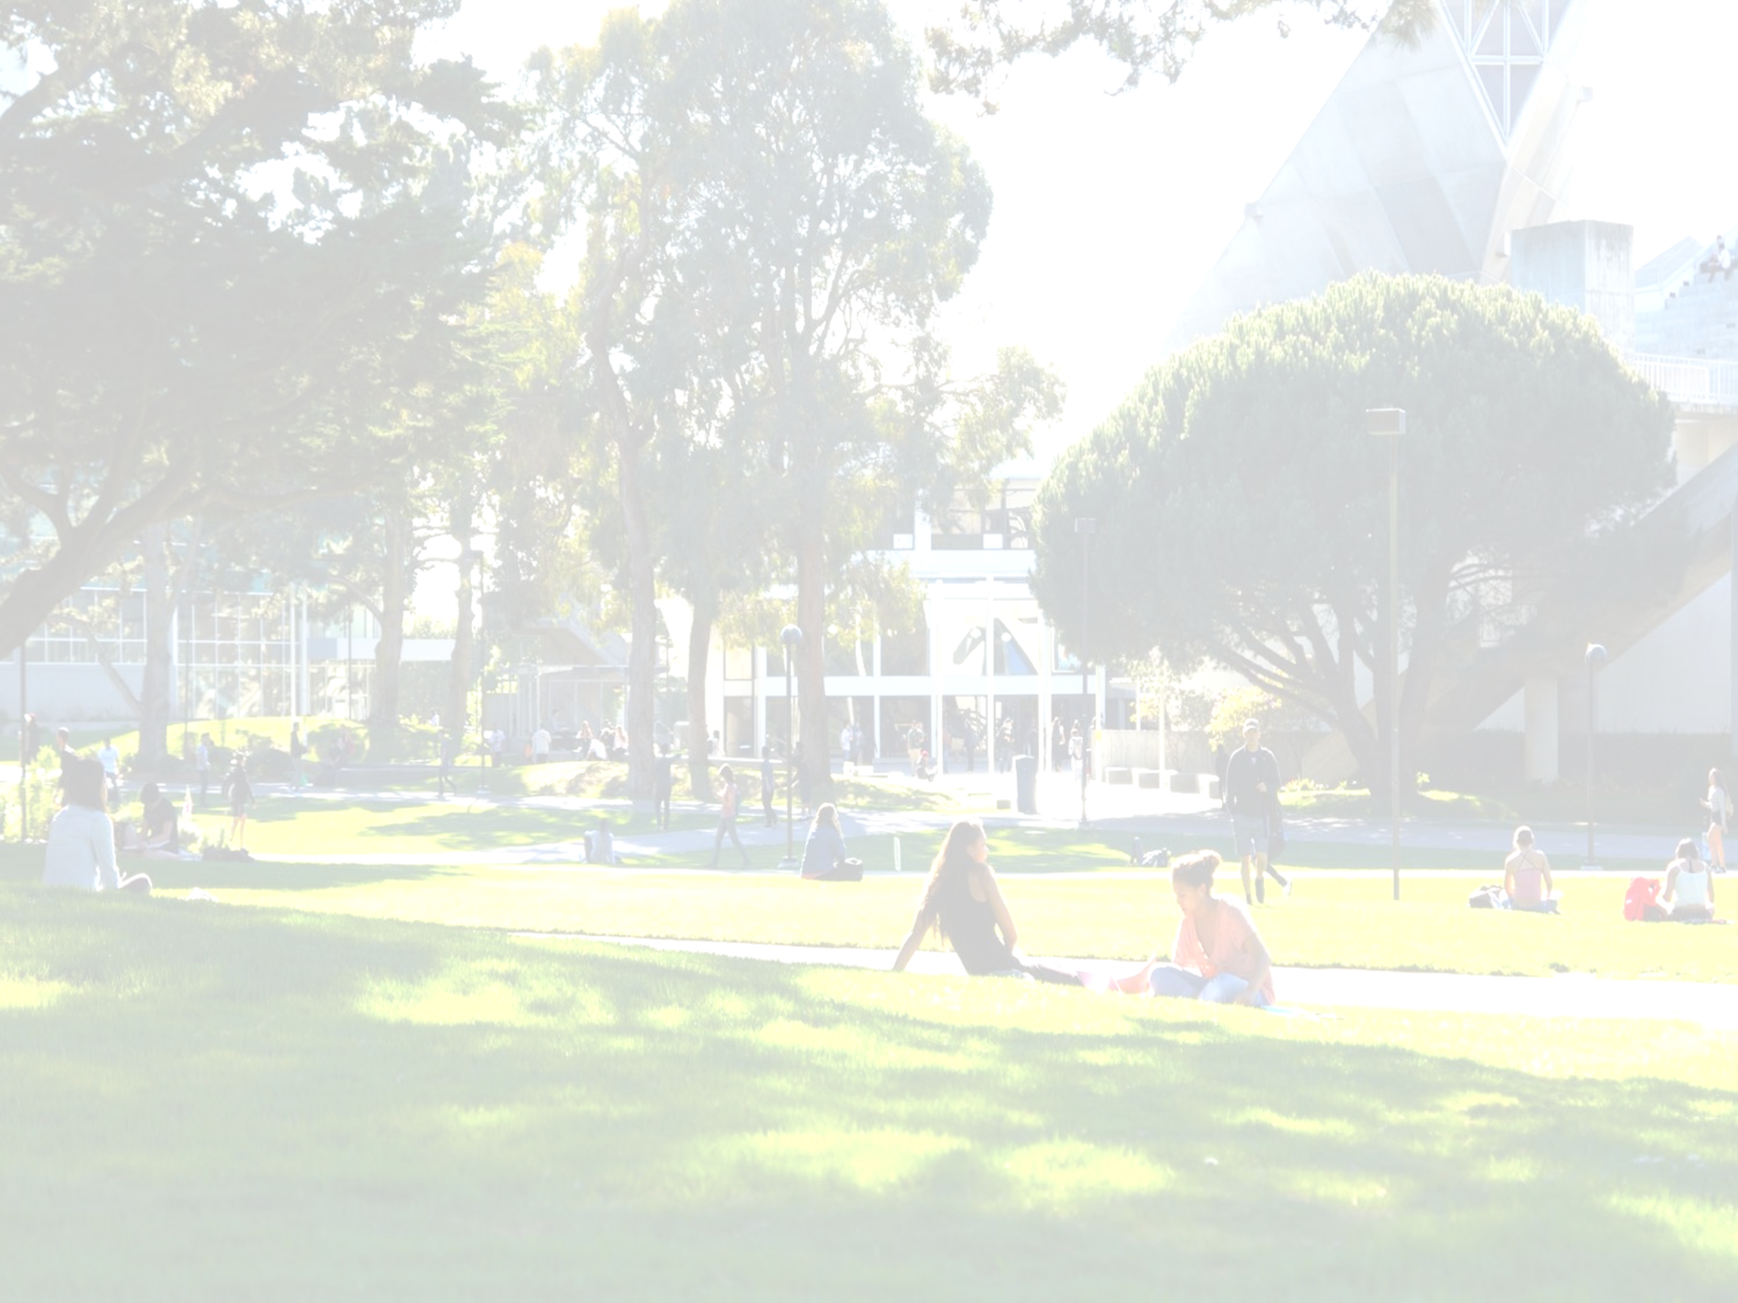
Service-learning is a form of experiential education that . . .
Community service-learning is a form of
experiential education that . . .
is developed, implemented, and evaluated in collaboration with the community;
responds to community-identified concerns;
attempts to balance the service that is provided and the learning that takes place;
enhances the curriculum by extending learning beyond the classroom and allowing students to apply what they’ve learned to real-world situations; and
provides opportunities for critical reflection.
is developed, implemented, and evaluated in collaboration with the community;
responds to community-identified concerns;
attempts to balance the service that is provided and the learning that takes place;
enhances the curriculum by extending learning beyond the classroom and allowing students to apply what they’ve learned to real-world situations; and
provides opportunities for critical reflection
Notes:
EUNICE

Slide 13


Social justice tenets
Full & equal participation
Equitable distribution of resources
Physical & psychological safety
Collective social responsibility
Inclusive leadership
Value, respect, & support for multiple identities of full community
Democratically achieved society affirming of human agency
Notes:
Maria

Slide 14

Social justice pedagogy
A framework for teaching that directly addresses power and privilege issues, reduces stereotype threat, uses a variety of pedagogical strategies that increase sense of belonging and communal values, models greater inclusivity and highlights the relevance of the content to students’ personal lives.
Notes:
Maria

Slide 15

The syllabus
First step in doing social justice in classroom
First signal to students/Sets tone for class
The syllabus is the “blueprint” of the course
Conveys norms and assumptions
Helps create sense of belonging for students
(Taylor, Veri, Eliason, Hermoso, Bolter, & Van Olphen, 2019)
Notes:
Maria

Slide 16

The syllabus (cont’d)
BEST PRACTICES
  Communal language
  Learning-focused
  Accessible
  Promote relevance
Promote growth mindset
Expectations for success
Inclusive representation
Student-centered
(Taylor, Veri, Eliason, Hermoso, Bolter, & Van Olphen, 2019)
Notes:
Maria

Slide 17
Social justice Syllabus design Tool
Assessment strategy
What does your syllabus say about you?
What does your syllabus say to students about the likelihood that they will fit in and be successful in your class?
(Taylor, Veri, Eliason, Hermoso, Bolter, & Van Olphen, 2019)
Notes:
Maria

Slide 18
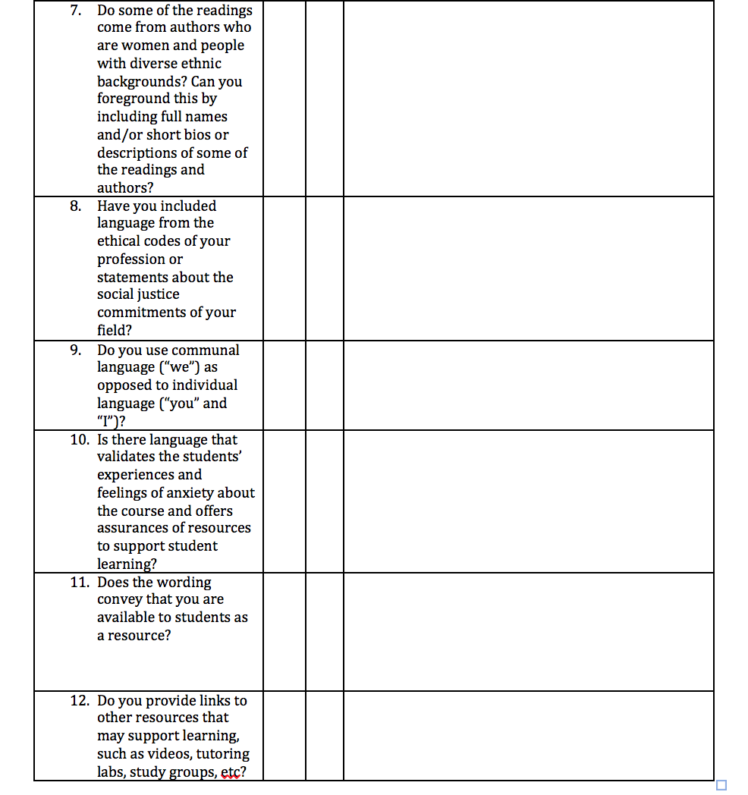
The syllabus design tool (cont’d)
(Taylor, Veri, Eliason, Hermoso, Bolter, & Van Olphen, 2019)
Notes:
Maria

Slide 19
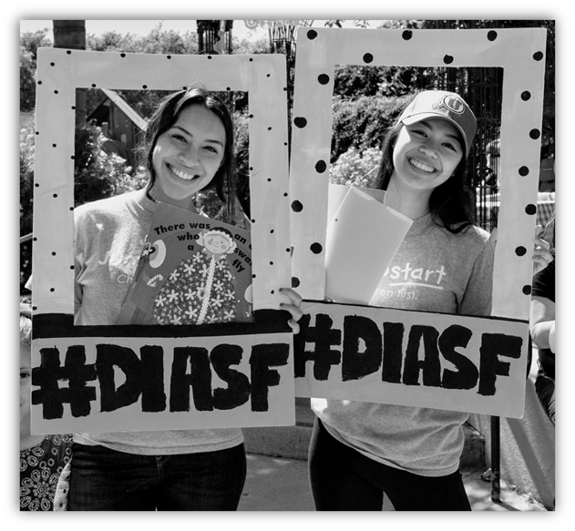
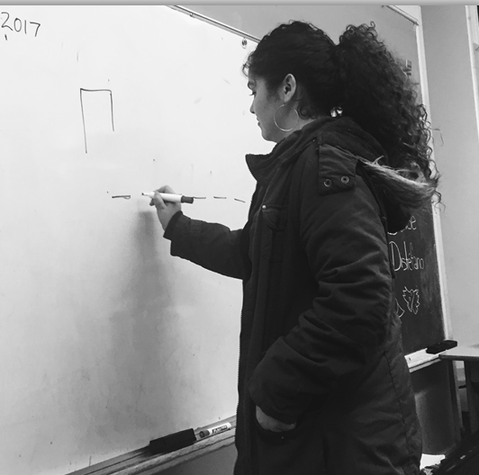

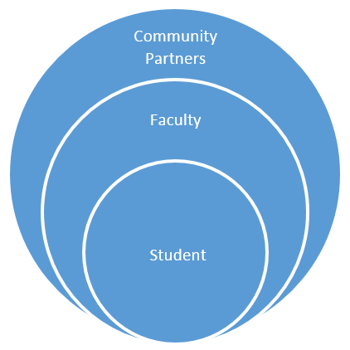
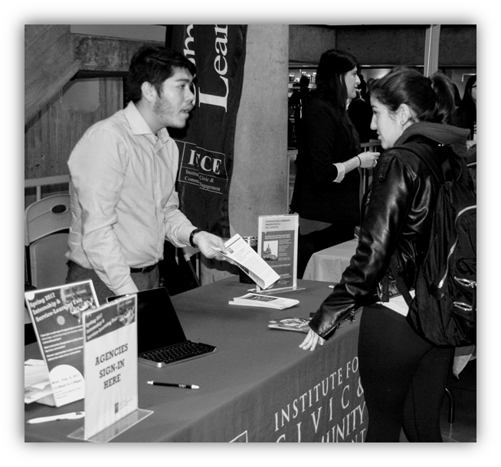
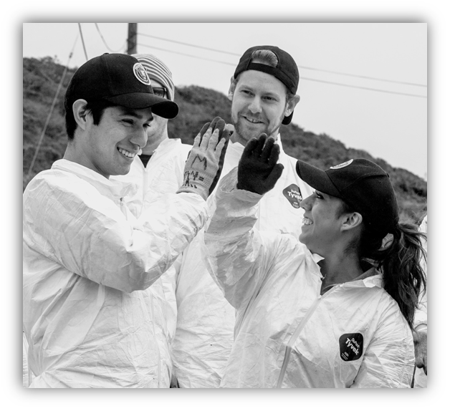
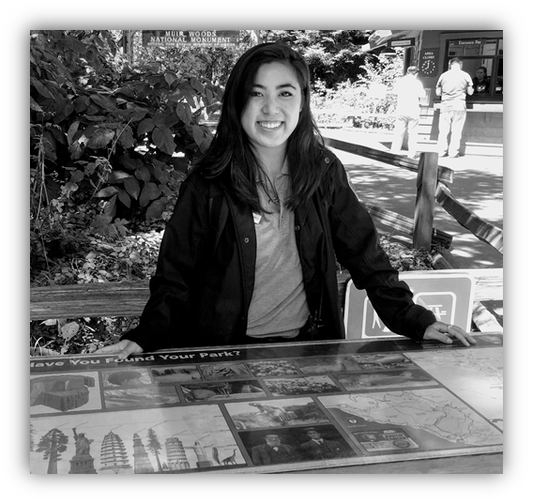
Student CSL Experiences
Faculty & Courses
Service-Learning Impacts
  Academic Learning Outcomes
  Personal Outcomes
  Social Outcomes
  Career Development
Notes:
NINA

Slide 20
CSL STUDENT LEARNING OUTCOMES (SLO’s)
Upon completion of a CSL designated course, students will be able to:
1. Analyze knowledge gained from their own academic study/field/discipline making relevant connections to community engagement and understand their civic responsibility based on experiential learning.
2. Articulate and critique the impact of their work in the community including discipline related reflection on how their own attitudes and beliefs are different from those of other cultures and communities. (e.g., exhibits curiosity about what can be learned from diversity of communities and cultures).
3. Identify and evaluate methods and best practices of community engagement of the related course discipline.
4. Improve their ability to link academic knowledge with community wisdom and expertise to apply what they have learned about a real-world issue in a socially responsible way.
5. Understand the effect of civic and/or community service learning on their interpersonal development, the ability to work well with others, leadership development, and communication skills.
Notes:
NINA

Slide 21
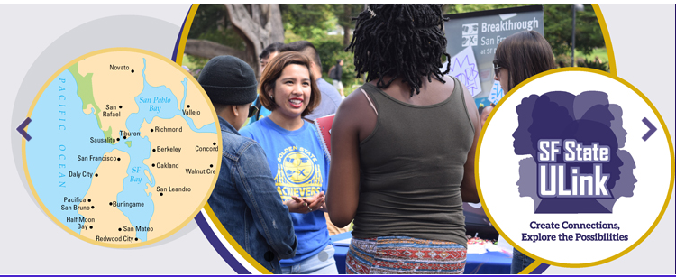
  SF State ULink (Fundly/eduConnect)
  https://www.sfstateulink.org
ULink is SF State's official community engagement online portal
  Promote & coordinate service learning projects/sites, co-curricular service & academic internships
  Showcase community engagement opportunities, research opportunities
  Track, manage & approve service hours
  Connect all stakeholders including faculty, students (teams) and community partners
  Collect and store various required forms and documents
  Risk Management: CSU EO 1064 compliant

Slide 22
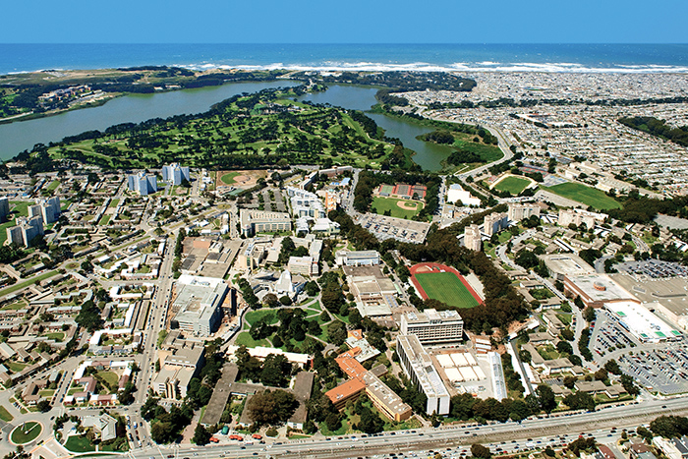
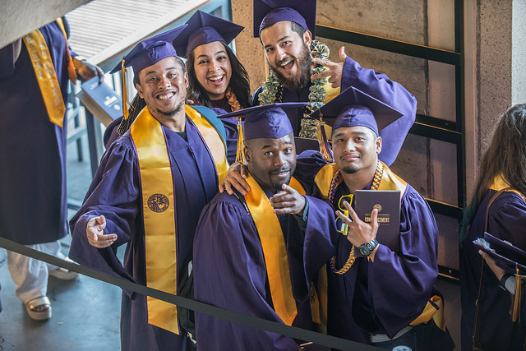
CSL Designation: OVERVIEW
Notes:
JEN

Slide 23
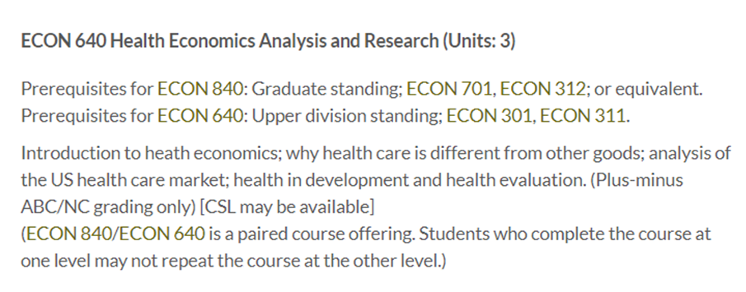
Academic Senate Policy, S03-224 (AY 2002-2003)
CSL courses are to be identified in the University Bulletin and in Class Schedules to help students identify CSL courses
Minimum criteria for designation of courses
Procedures for approving designation as a service learning course
SAMPLE:
Notes:
JEN

Slide 24
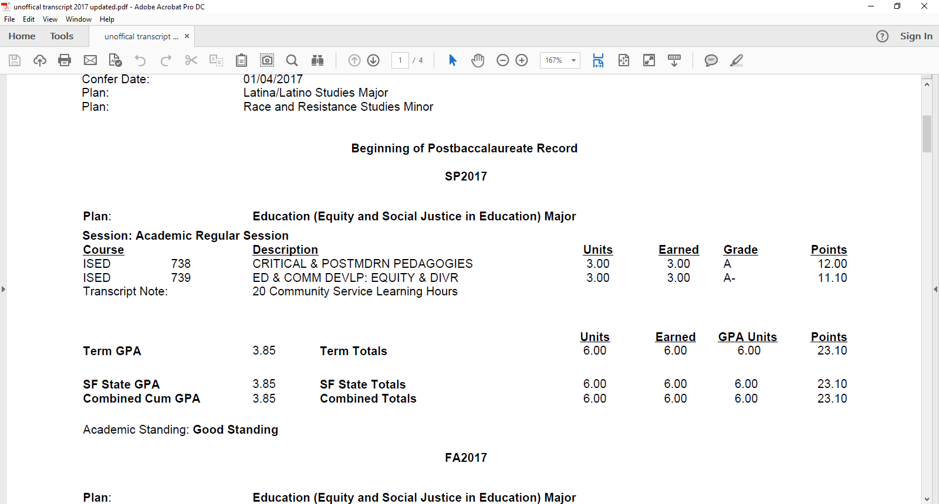
Benefits of CSL designation for students, faculty and university community
Standard language for a service-learning appears on the SF State bulletin for your course
Hours appear on student transcripts to document academic service-learning and community-based experiences
It helps ICCE and the university track the prevalence of CSL courses and provide specialized support to instructors (e.g., access to service-learning assessment tools and faculty development opportunities)
Allows faculty to document their time spent teaching service-learning courses
Provides an opportunity for service assignments/projects to address a community-identified need and educate students about social justice issues addressing “real world” challenges
Notes:
JEN

Slide 25
Notes:
JEN

Slide 26
Groups of 3-4 ~ Let’s chat about Your syllabi!
To infuse Social Justice and Service Learning consider a mock (or real) student project or assignment – how would you respond to the following:
Quality: What is the degree to which service, reflection, AND social justice are integrated into your course curricula? (not as extra credit or a side project in the class!)
Community Needs/Engagement: What is the extent to which the service component addresses some sort of community-identified needs and/or goals around social justice issues?
Incorporating Social Justice: How can you incorporate social justice principles into your syllabus for a service-learning project or assignment?
Evaluation: How will you evaluate impact and outcome of service‐learning as an effective pedagogy? (Remember, 5 SLOs have been created for CSL. Would you be willing to help pilot 1 or more in your class!?)

Slide 27
Resources for Faculty
Sample CHSS and/or ICCE services include:
Develop and screen academic internship and service-learning opportunities for appropriateness, safety, and University standards
Promote service-learning, academic internships, and volunteer opportunities to our CHSS community and SF State campus as a whole
Deliver classroom orientation about academic internships, service-learning, and community engagement database (ULink)
Faculty service-learning small grants (including for research)
Risk management process and procedures
Library on experiential education books, journals, and other materials
Faculty development opportunities (varied topics)
Support for Review, Tenure, & Promotion process
Notes:
NINA

Slide 28



THANK YOU & GOOD LUCK!
Questions | Comments?
Notes:
ALL STAFF

