Slide 1
Using Journaling to Develop a Reflective Teaching Practice
Workshop Facilitated by Verónica Rabelo (she / they)
Assistant Professor of Management, College of Business
September 30, 2019 | HSS Teaching Academy, SF State

Slide 2
¡Hola!
Verónica Rabelo, PhD
I am here because I love exploring and sharing different tools for planning + reflection.
Follow up with me on Twitter @VeroRabeloPhD or email me at rabelo@sfsu.edu.

Slide 3
Learning Objectives
Metacognition
Reflect on past methods for reflecting on pedagogy and teaching effectiveness
Goal-Setting
Utilize journaling as a tool to develop, deepen, and maintain a reflective teaching practice

Slide 4
Workshop Handout
View the handout
Copy the handout

Slide 5
1.
Overview
Semester Planning as a Juggling Act

Slide 6
What are your responsibilities? roles, projects, tasks, goals, etc.
How do you manage these responsibilities?
scheduling, prioritizing, delegating, etc.
How do you reflect on these responsibilities?
after each day, week/unit, term, etc.

Slide 7
2.
Semester Mapping
How can we apply journaling techniques to academia?

Slide 8
Benefits of Journaling Techniques
Manage time (busyness vs. productivity)
Manage projects (especially collaborative research)
Manage boundaries + energy
Manage multiple goals + roles
Other benefits?

Slide 9
Using Journaling for Semester Mapping
Teaching
Dashboard
Assignment extensions
Professional development
Research
Pipeline
Conference + CFP deadlines
Funding sources + balances
Service
Committees
Significant contributions
Invisible labor

Slide 10
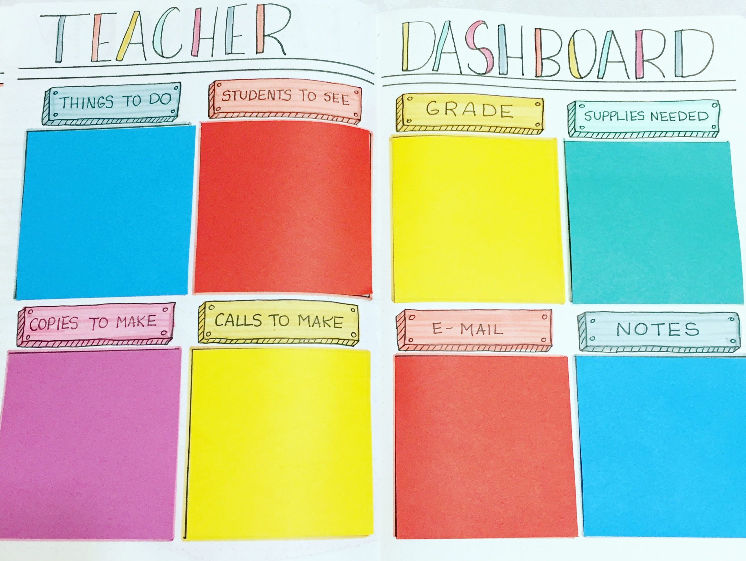
Teaching Dashboard
source blog:
Alexandra Plans

Slide 11
Professional Development Log
source blog:
Alexandra Plans

Slide 12
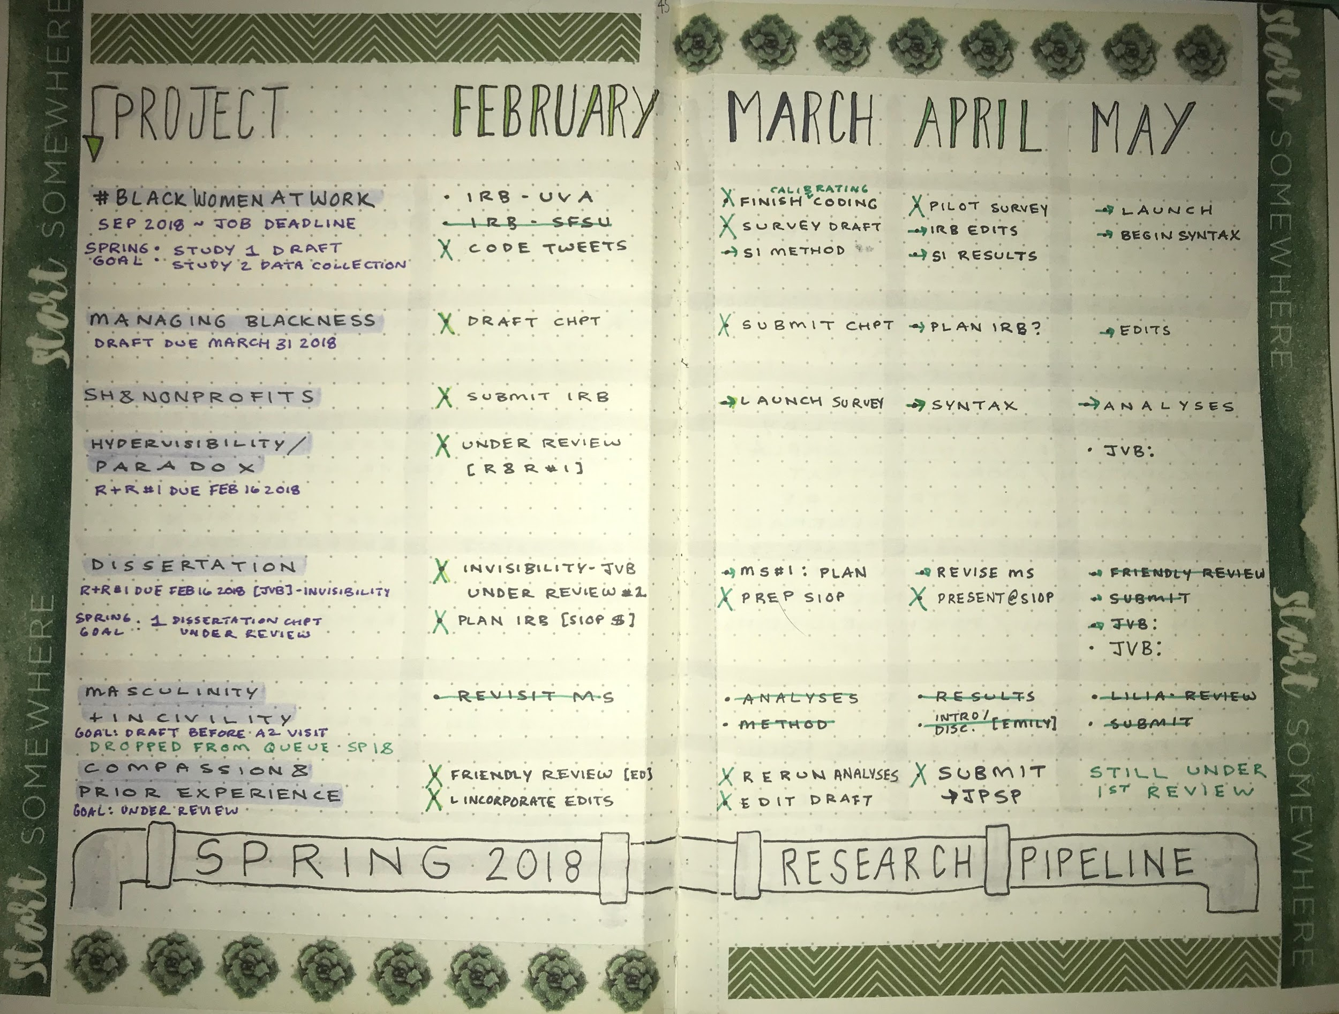
Research Pipeline
created by Verónica Rabelo

Slide 13
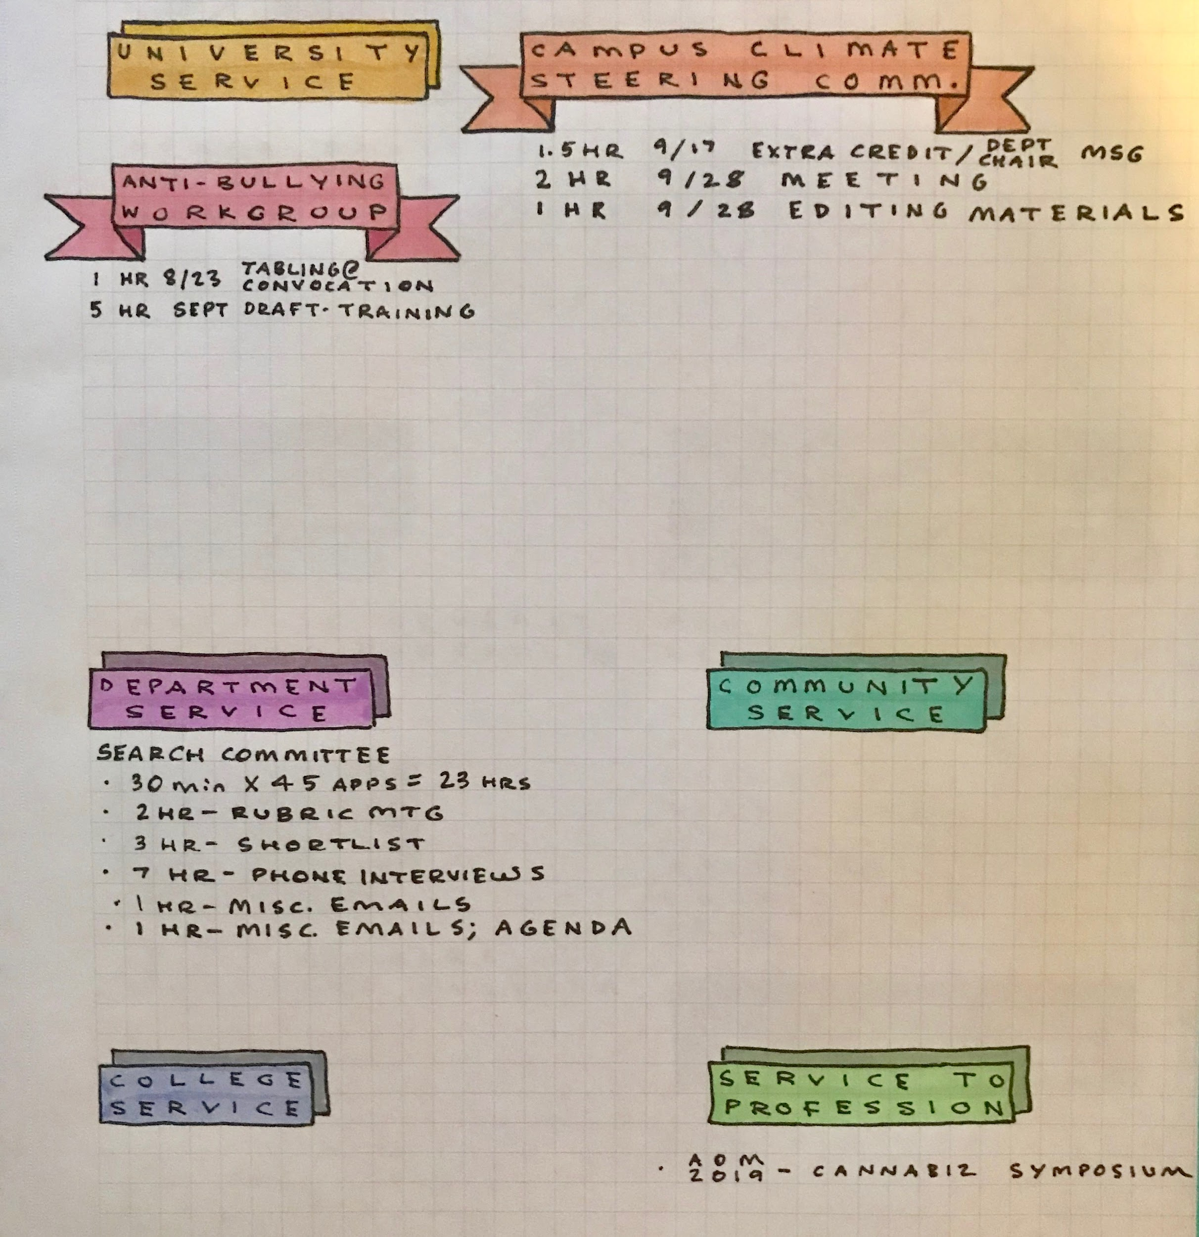
Service Log + Committee Work Tracking
created by
Verónica Rabelo

Slide 14
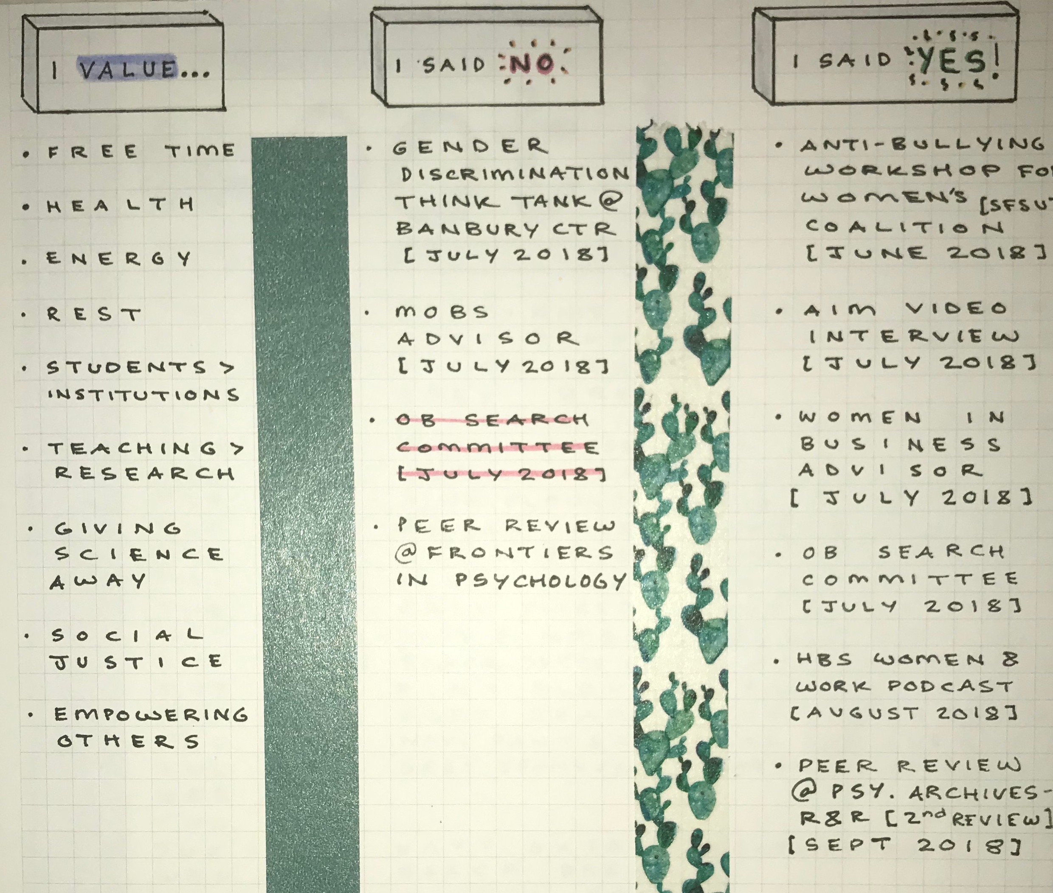
Yes / No Log
created by Verónica Rabelo

Slide 15
3.
Building a Reflective Practice
How can we build and integrate a reflective practice through our journaling?

Slide 16
What are some ways that you have reflected on your teaching?
after each day, week/unit, term, etc.
How has this reflection shifted your teaching?

Slide 17
Daily + Weekly Reflection
What went well and why? What were the highlights?
Were there any unexpected or uncomfortable moments?
What questions did my students ask?
When did my students + I feel most/least energized?
Consider conducting an Energy Audit
What adjustments should I make next week / semester?

Slide 18
Daily + Weekly Reflection
What are some additional questions that would be helpful to ask yourself on a daily and/or weekly basis?
For additional ideas, consult this resource:
10 Reflective Questions for Teachers to Use Every Day

Slide 19
Monthly + End-of-Semester Reflection
What are my priorities? How can I “protect” these priorities?
What are my big-picture goals?
How can I break down these goals into smaller chunks?
How can I celebrate “small wins” as well as goal completion?
What are some areas of improvement on which I’d like to focus?
What are factors or strategies that help me maintain momentum?
How can I set SMART goals to make meaningful and noticeable progress?

Slide 20
Monthly + End-of-Semester Reflection
What are some additional questions that would be helpful to ask yourself on a monthly basis and/or at the end of each semester?
For additional ideas, consult these resources:
Reflecting on Your Practice
20 Teacher End of the Year Reflection Questions

Slide 21
4.
Maintaining a Reflective Practice
How can we use journaling to maintain a reflective practice?

Slide 22
Turning Reflection Into a Habit
❐ Analog (e.g., journal, notebook, planner)
❐ App (e.g., Day One, Diarium, others?)
❐ Survey (e.g., Qualtrics, Google form)
❐ Digital (e.g., Notes app, word processor, spreadsheet, email draft/chain)
❐ Relational (e.g., coffee meetings, virtual accountability groups)
What are other systems that can help you maintain a reflective teaching practice?

Slide 23
5.
Additional Resources
Where can you learn more about journaling and building a reflective teaching practice?

Slide 24
This workshop is just the beginning.
Remember that you are each other’s most valuable resource! I encourage you to share ideas, resources, best practices, and lessons learned related to building a reflective teaching practice.

Slide 25
Resources
Values and Goals Clarification worksheet
Promoting Student Metacognition research article by Kimberly D. Tanner, SFSU faculty member in Biology
includes excellent prompts for reflective thinking
Mobile apps for reflection in learning: A design research in K‐12 education research article
18 Essential Apps For The Organized Teacher blog post

Slide 26
Blog - Pretty Prints & Paper by jess
Get Started with the Bullet Journal
Back to School: Making Planners Work for You
Saying No: Having Balance & Boundary
Project Planning in my Bullet Journal
16 Bullet Journal Layouts for Educators

Slide 27
¡Gracias!
Any questions?

Slide 28
Credits
Special thanks to people who provided feedback:
Kristen (Bullet Journal for Higher Ed Faculty and Staff groupie)
Deb Perry, Leilani Serafin, Heidi Fridriksson, and Teggin Summers (Center for Equity and Excellence in Teaching and Learning, San Francisco State University)

